Slide 1

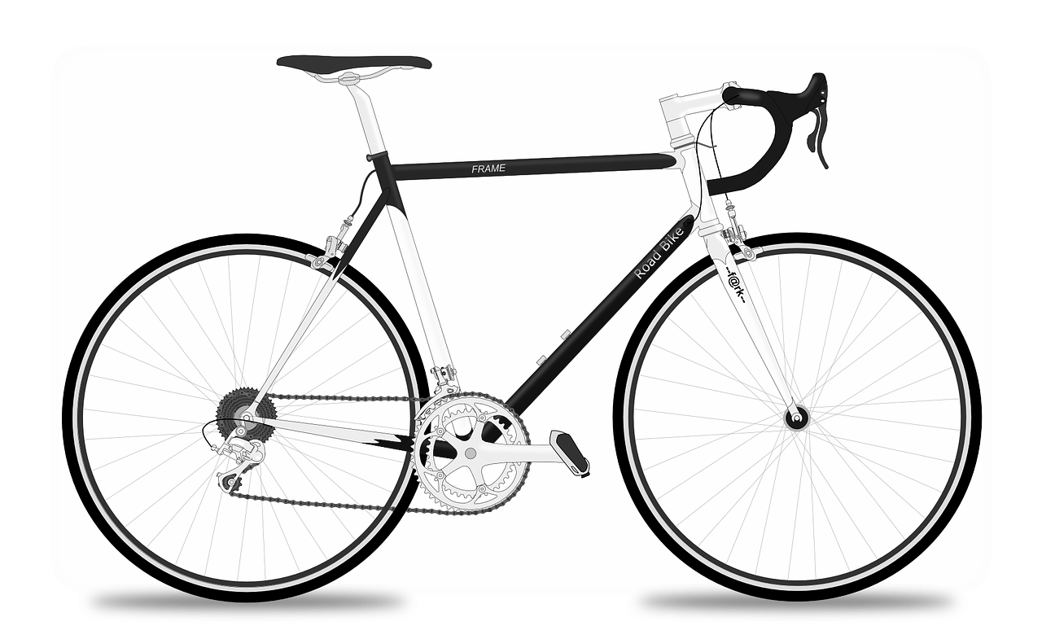
Year 5 – Systems and searching Lesson 1 – Systems | Learner activity sheet
Bicycle system
Resources are updated regularly — the latest version is available at: ncce.io/tcc.
This resource is licensed under the Open Government Licence, version 3. For more information on this licence, see ncce.io/ogl.
Notes:
Late updated 31-01-22
Image source: https://pixabay.com/vectors/racing-bicycle-racer-racing-bike-161449/

